Slide 1


REC CAMPUS EXPLORER
HOME
ABOUT
CONTENT
OTHERS
3D COLLEGE NAVIGATION APP
PRESENTED BY
KARTHIK N 221701028
LOKESHWAR S R 221701504

Slide 2
REC CAMPUS EXPLORER
REC CAMPUS EXPLORER
HOME
ABOUT
CONTENT
OTHERS
Abstract
This project aims to develop a 3D navigation app for college campuses, providing an interactive and immersive alternative to traditional 2D maps. Utilizing advanced 3D modeling techniques, the app creates a realistic campus representation, enabling users to explore their surroundings, locate buildings, and navigate to destinations with enhanced accuracy and efficiency.

Slide 3
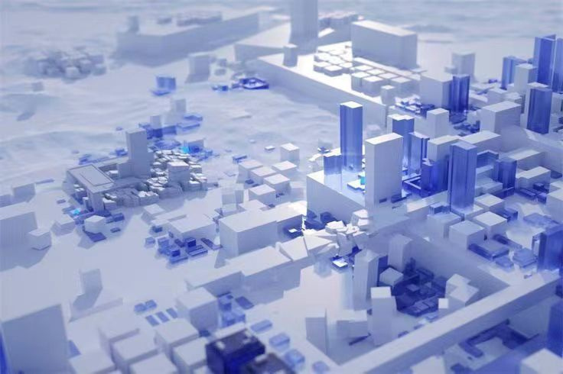
REC CAMPUS EXPLORER
HOME
ABOUT
CONTENT
OTHERS
OBJECTIVE
Develop 3D Model
Create a high-fidelity 3D model of the college campus, incorporating accurate building layouts, outdoor spaces, and landmarks.
Implement Navigation Features
Enable users to navigate the campus environment in 3D, providing real-time directions and wayfinding assistance.
User-Friendly Interface
Design an intuitive user interface that is easy to navigate and understand for all users, regardless of their technical expertise

Slide 4


REC CAMPUS EXPLORER
CONTENT
HOME
ABOUT
OTHERS
3D Modeling Approach
Use Basic Shapes for Buildings & Paths
Only Model Key Landmarks
Optimize for Performance
Use low-poly models to ensure smooth navigation. Keep models lightweight by avoiding high-detail meshes and complex lighting
Model buildings as simple cubes with minimal details. Use flat colors or basic textures instead of complex materials.
Include main buildings, roads, and entry points while skipping small objects.

Slide 5
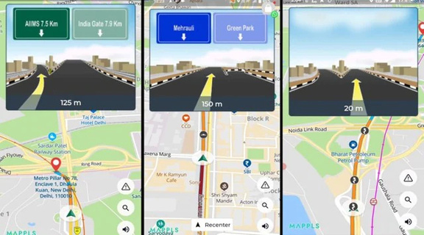
REC CAMPUS EXPLORER
Thynk Unlimited
HOME
ABOUT
CONTENT
OTHERS
Existing Applications
Mappls
Offers precise GPS navigation, customizable maps, indoor & outdoor routing, and real-time updates.
University of York Navigation App
Offers precise GPS navigation, customizable maps, indoor & outdoor routing, and real-time updates.

Slide 6

REC CAMPUS EXPLORER
HOME
ABOUT
CONTENT
OTHERS
LOGO

Slide 7
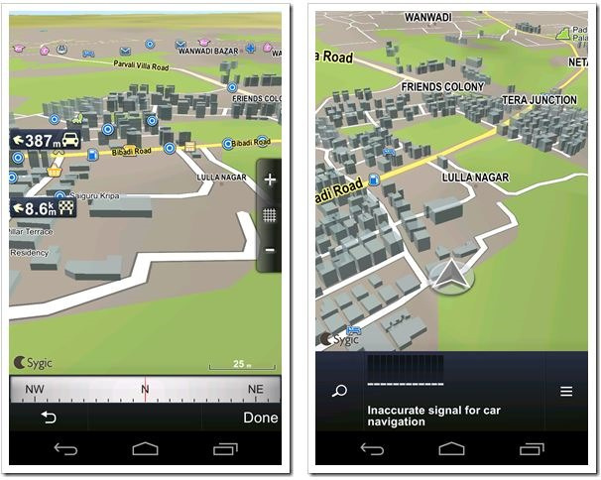
Thynk Unlimited
HOME
ABOUT
CONTENT
OTHERS
EXPECTED OUTPUT
A fully functional 3D navigation app for the college campus.
A realistic 3D model of key campus locations for interactive exploration.
Real-time GPS tracking to determine the user's current location.
Predefined destination selection with an automatically generated route.
Outdoor navigation using a LineRenderer-based path.
Indoor navigation utilizing NavMesh for precise routing.
Smooth pan, zoom, and rotate controls for an intuitive user experience.
Offline functionality with manual route calculation.
Improved navigation accuracy compared to traditional 2D maps.

Slide 8
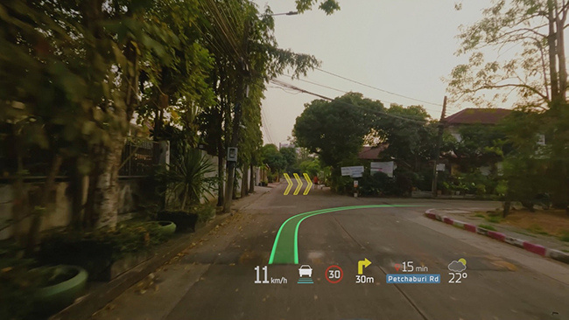
Thynk Unlimited
HOME
ABOUT
CONTENT
OTHERS
Future Enhancement
Augmented Reality (AR) & Accessibility Enhancements – Integrating AR for real-world navigation overlays, along with voice guidance, haptic feedback, and wheelchair-friendly routes for inclusivity.
Smart Features & Campus Integration – AI-powered route optimization, multilingual support, real-time campus updates, cloud-based dynamic maps, and gamification for an interactive user experience.

Slide 9
REC CAMPUS EXPLORER
CONTENT
HOME
ABOUT
OTHERS
THANK YOU

Slide 10


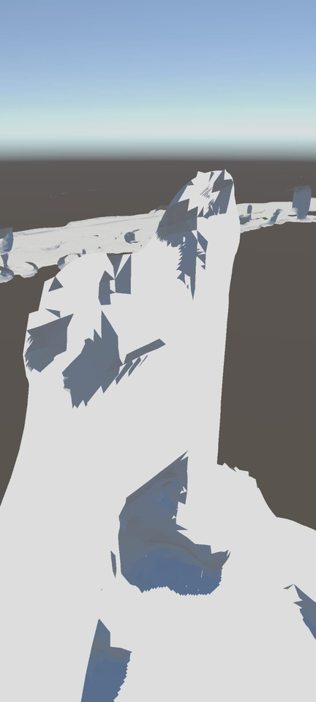

Slide 11
